Slide 1
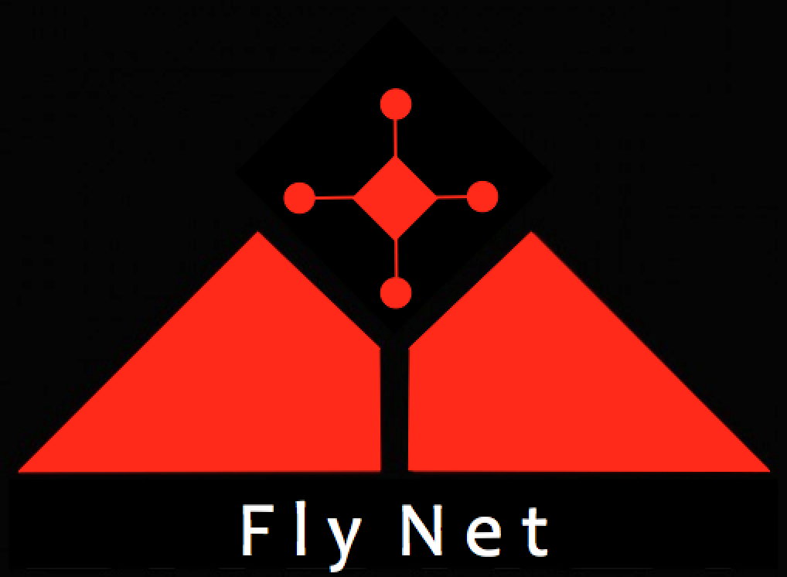

FlyNet: Autonomous Quadcopter Search and Rescue
Pixhawk/flight controller
Guidance
Custom
Desired velocity
a_{x-body,} a_{y-body} , a_{z-body}
p, q, r
ϕ_{d} θ_{d} ψ_{d}
Map Metrics
Map
Desired trajectory
p_{d} q_{d} r_{d}
ϕ_{d} θ_{d} ψ_{d}
Vis. Odom.
Vis. Odom.
Vis. Odom.
ϕ_{d} θ_{d} ψ_{d}
Depth images,
Ultrasonic readings
Vis. Odom.
F, M
Desired Position
Z_{intertial-des}
Depth images,
Ultrasonic readings
Notes:
Controller decision, what does that?

Slide 2
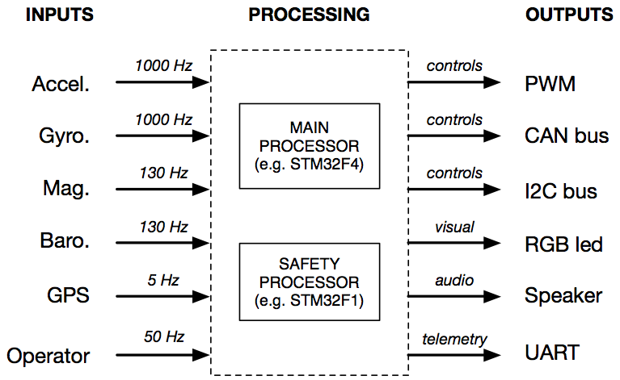
Sensors
FlyNet: Autonomous Quadcopter Search and Rescue
Notes:
Replace gps with local ned

Slide 3
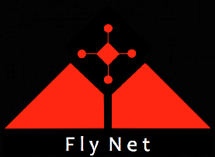
Pixhawk – Off-board Computer Interface
FlyNet: Autonomous Quadcopter Search and Rescue
Embedded Controller (Pixhawk)
Linux Companion Computer
Actuator & Sensor Interface
Safety Controller
SLAM
Obstacle Avoidance
uORB publish/subcribe bus
ROS publish/subscribe bus
UART MAVlink
>250 Hz
< 1 ms latency
Local NED Subscriber
Planner Generated Set point
Local NED Publisher
Path
Planner
Position Controller
Custom
Attitude Controller
Modified
Preexisting

Slide 4
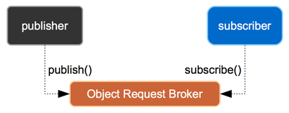
Pixhawk Application Framework
FlyNet: Autonomous Quadcopter Search and Rescue

Slide 5
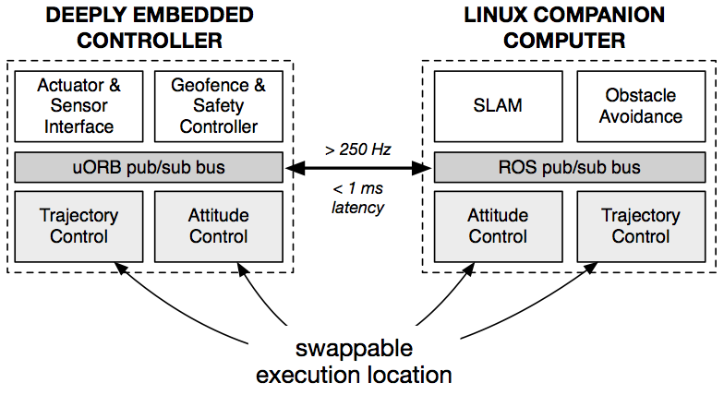
High Level Architecture
FlyNet: Autonomous Quadcopter Search and Rescue
Notes:
What bus/protocol

Slide 6
FlyNet: Autonomous Quadcopter Search and Rescue

